Slide 1

CSE 423
Virtualization and Cloud Computing
Lecture 19
Module V
Dr. Madhavi Dhingra

Slide 2
Contents
Google File system
Hadoop Distributed File System
Comparison of Features

Slide 3
Cloud File System
The file system is a kind of Data structure or method which we use in an operating system to manage file on disk space. This means it allows the user to keep maintain and retrieve data from the local disk.
An example of the windows file system is NTFS(New Technology File System) and FAT32(File Allocation Table 32). FAT32 is used in some older versions of windows but can be utilized on all versions of windows xp. Similarly like windows, we have ext3, ext4 kind of file system for Linux OS.
Cloud file system is having a distributed file system.
Key features:
A distributed file system is basically used for storing huge amount of data and provide accessibility of stored data to all the distributed clients across the network.
The objective of DFS is to provide a system for all the geographically distributed users as a common file system for data sharing and storage.
DFS comprises various software components that run as a single system entity on multiple systems. Internet Search Engine is the most common example of DFS.
Some common examples of file systems are Network File System
(NFS), Coda, Microsoft Distributed File System (DFS), GFS and HDFS.

Slide 4
Google File System
GFS is made to meet Google’s huge cluster requirements. Hierarchical directories with path names are used to store files. The master is in charge of managing metadata, including namespace, access control, and mapping data. The master communicates with each chunk server by timed heartbeat messages and keeps track of its status updates.
GoogleFS is another name for GFS. It manages two types of data namely File metadata and File Data.
The GFS node cluster consists of a single master and several chunk servers that various client systems regularly access. On local discs, chunk servers keep data in the form of Linux files. Large (64 MB) pieces of the stored data are split up and replicated at least three times around the network. Reduced network overhead results from the greater chunk size.

Slide 5
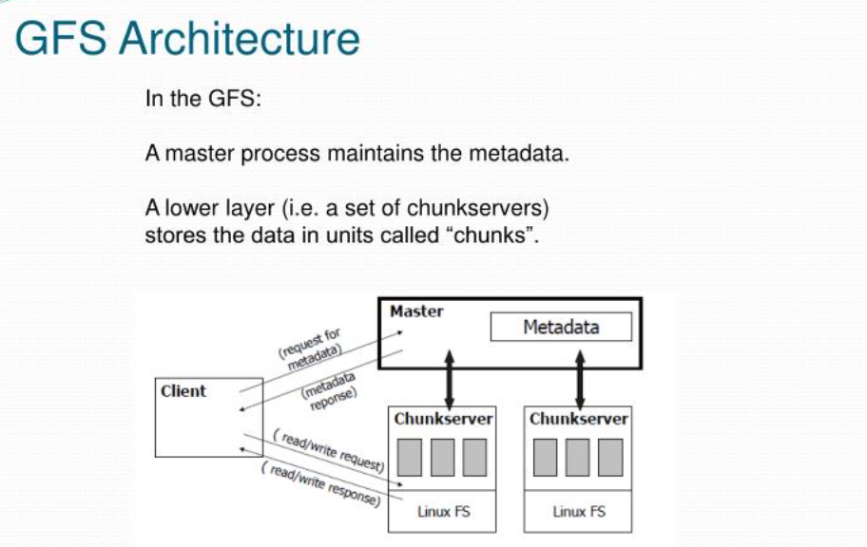

Slide 6
Components of GFS
A group of computers makes up GFS. A cluster is just a group of connected computers. There could be hundreds or even thousands of computers in each cluster. There are three basic entities included in any GFS cluster as follows:
GFS Clients: They can be computer programs or applications which may be used to request files. Requests may be made to access and modify already-existing files or add new files to the system.
GFS Master Server: It serves as the cluster’s coordinator. It preserves a record of the cluster’s actions in an operation log. Additionally, it keeps track of the data that describes chunks, or metadata. The chunks’ place in the overall file and which files they belong to are indicated by the metadata to the master server.
GFS Chunk Servers: They are the GFS’s workhorses. They keep 64 MB-sized file chunks. The master server does not receive any chunks from the chunk servers. Instead, they directly deliver the client the desired chunks. The GFS makes numerous copies of each chunk and stores them on various chunk servers in order to assure stability; the default is three copies. Every replica is referred to as one.

Slide 7
GFS
Advantages of GFS
High accessibility Data is still accessible even if a few nodes fail. (replication)
Excessive throughput. many nodes operating concurrently.
Dependable storing. Data that has been corrupted can be found and duplicated.
Disadvantages of GFS
Not the best fit for small files.
Master may act as a bottleneck.
Suitable for procedures or data that are written once and only read (appended) later.

Slide 8
HDFS
HDFS(Hadoop Distributed File System) is utilized for storage permission is a Hadoop cluster. It mainly designed for working on commodity Hardware devices(devices that are inexpensive), working on a distributed file system design. HDFS is designed in such a way that it believes more in storing the data in a large chunk of blocks rather than storing small data blocks. HDFS in Hadoop provides Fault-tolerance and High availability to the storage layer and the other devices present in that Hadoop cluster.

Slide 9
HDFS
HDFS is capable of handling larger size data with high volume velocity and variety makes Hadoop work more efficient and reliable with easy access to all its components. HDFS stores the data in the form of the block where the size of each data block is 128MB in size which is configurable means you can change it according to your requirement in hdfs-site.xml file in your Hadoop directory.
Some Important Features of HDFS(Hadoop Distributed File System)
It’s easy to access the files stored in HDFS.
HDFS also provides high availability and fault tolerance.
Provides scalability to scaleup or scaledown nodes as per our requirement.
Data is stored in distributed manner i.e. various Datanodes are responsible for storing the data.
HDFS provides Replication because of which no fear of Data Loss.
HDFS Provides High Reliability as it can store data in a large range of Petabytes.
HDFS has in-built servers in Name node and Data Node that helps them to easily retrieve the cluster information.
Provides high throughput.

Slide 10
HDFS
Hadoop works on the MapReduce algorithm which is a master-slave architecture, HDFS has NameNode and DataNode that works in the similar pattern.
1. NameNode(Master)
2. DataNode(Slave)
1. NameNode: NameNode works as a Master in a Hadoop cluster that Guides the Datanode(Slaves). Namenode is mainly used for storing the Metadata i.e. nothing but the data about the data. Meta Data can be the transaction logs that keep track of the user’s activity in a Hadoop cluster.
Meta Data can also be the name of the file, size, and the information about the location(Block number, Block ids) of Datanode that Namenode stores to find the closest DataNode for Faster Communication. Namenode instructs the DataNodes with the operation like delete, create, Replicate, etc.
As our NameNode is working as a Master it should have a high RAM or Processing power in order to Maintain or Guide all the slaves in a Hadoop cluster. Namenode receives heartbeat signals and block reports from all the slaves i.e. DataNodes.

Slide 11
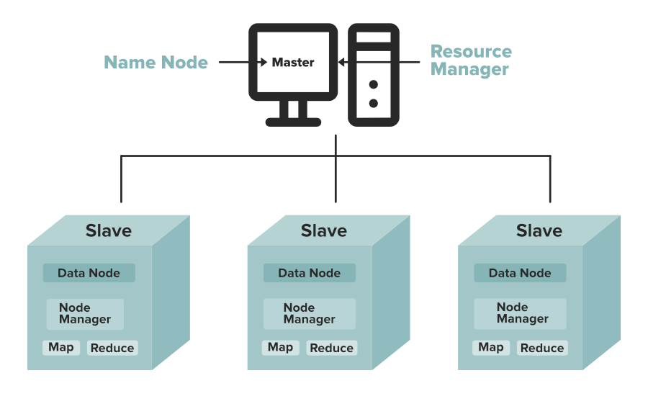
HDFS
2. DataNode: DataNodes works as a Slave DataNodes are mainly utilized for storing the data in a Hadoop cluster, the number of DataNodes can be from 1 to 500 or even more than that, the more number of DataNode your Hadoop cluster has More Data can be stored. so it is advised that the DataNode should have High storing capacity to store a large number of file blocks. Datanode performs operations like creation, deletion, etc. according to the instruction provided by the NameNode.

Slide 12
Advantages of HDFS
Cost effectiveness. The DataNodes that store the data rely on inexpensive off-the-shelf hardware, which cuts storage costs. Also, because HDFS is open source, there's no licensing fee.
Large data set storage. HDFS stores a variety of data of any size -- from megabytes to petabytes -- and in any format, including structured and unstructured data.
Fast recovery from hardware failure. HDFS is designed to detect faults and automatically recover on its own.
Portability. HDFS is portable across all hardware platforms, and it is compatible with several operating systems, including Windows, Linux and Mac OS/X.
Streaming data access. HDFS is built for high data throughput, which is best for access to streaming data.

Slide 13
Disadvantages of HDFS
1. System Failure: As a Hadoop cluster is consists of Lots of nodes with are commodity hardware so node failure is possible, so the fundamental goal of HDFS figure out this failure problem and recover it.
2. Maintaining Large Dataset: As HDFS Handle files of size ranging from GB to PB, so HDFS has to be cool enough to deal with these very large data sets on a single cluster.
3. Moving Data is Costlier then Moving the Computation: If the computational operation is performed near the location where the data is present then it is quite faster and the overall throughput of the system can be increased along with minimizing the network congestion which is a good assumption.
4. Portable Across Various Platform: HDFS Posses portability which allows it to switch across diverse Hardware and software platforms.
5. Simple Coherency Model: A Hadoop Distributed File System needs a model to write once read much access for Files. A file written then closed should not be changed, only data can be appended. This assumption helps us to minimize the data coherency issue. MapReduce fits perfectly with such kind of file model.

